Slide 1
Test Log Photos

Slide 2

#1

Slide 3
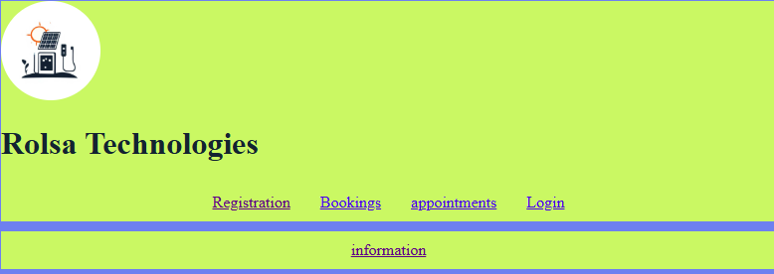
#2

Slide 4
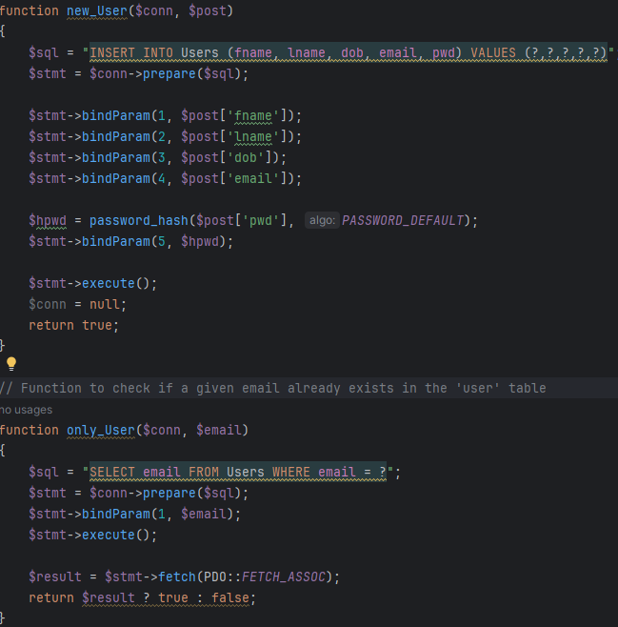
#3

Slide 5
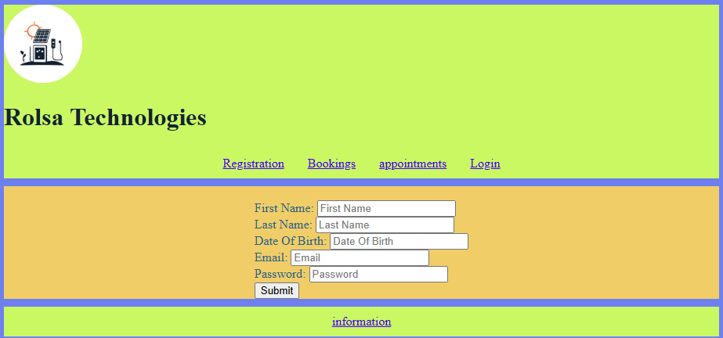
#4

Slide 6
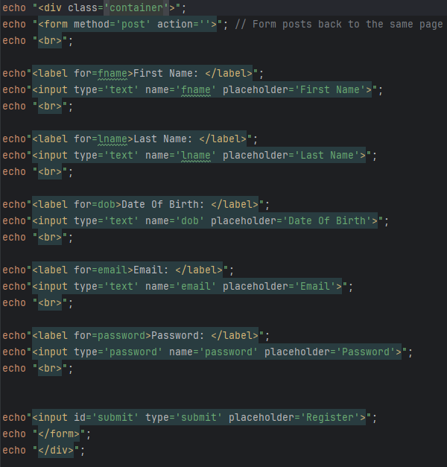
#5

Slide 7
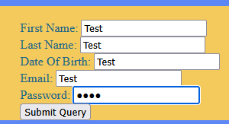
#6

Slide 8
#7

Slide 9
#8

Slide 10
#9

Slide 11
#10

Slide 12
#11

Slide 13
#12

Slide 14
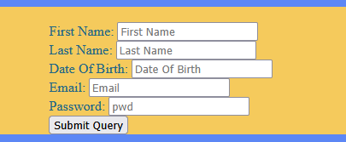
#13

Slide 15
#14

Slide 16
#15

Slide 17
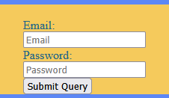
#16

Slide 18
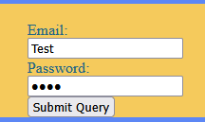
#17

Slide 19
#18

Slide 20
#19

Slide 21
#20

Slide 22
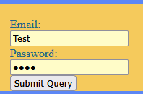
#21

Slide 23
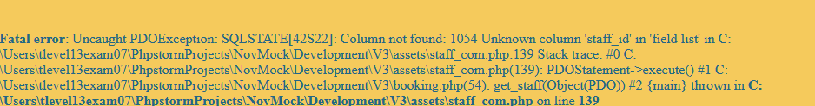
#22

Slide 24
#23

Slide 25
#24

Slide 26
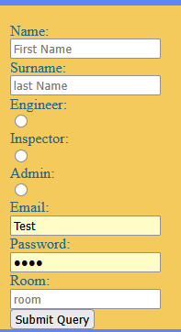
#25

Slide 27
#26

